Slide 1
CodeU’s
Bootcamp
Chapter 2
Welcome to your 5th session!
The class will start shortly...
Reproduction and distribution of the presentation deck is prohibited

Slide 2
Agenda for today’s class
Kahoot!
01
02
Homework correction
To recap what was seen last class!
Let’s correct last week’s homework!
Topic of the day:
03
04
Practice time!
-For Loop
-Practice exercises
Let’s practice with some coding exercises!
Wrap-up
Conclusion
05
06
CodeU Robot
Summary of what we’ve learned today
homework and questions

Slide 3
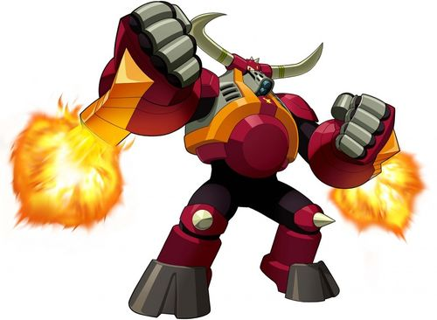
Homework: Defeat the Final Boss!
Homework Description
You must build a game where a user must face a final boss. In this dual, the player must guess the boss's number to attack!
Solution
#Import the Random module
import random
#Create a variable for the boss’s lives
boss_lives = 5
#Create your while loop that ends once the boss has no more lives
while boss_lives != 0:
boss_nb = random.randrange(1,10)
player_nb = int(input("What is your guess: "))
#Create your conditional
if boss_nb == player_nb:
print("You and the final boss both guessed: " + boss_nb)
print("\nYour attack was successful!")
boss_lives -= 1
print("\nYou have defeated the boss!")

Slide 4

Time for Kahoot!
Head over to Kahoot.it for a fun coding quiz!

Slide 5
Introduction to FOR Loop!
01
What is For?
With CodeU, we’ll only be seeing the FOR Loop using Lists and Strings.
A for loop in Python allows you to repeat a set of instructions for each element in a sequence, such as a list or a string. It is initiated using the "for" keyword.
Example: We have a list of grocery items and we want to count the number of items in our list, we can use a for loop!
02
What can we use?
Syntax Example
Students = [“Sahil”, “Clara”, “Giuseppe”, “Oliver”]
for i in students: print(i)
Result: This will print every student in the list, starting with the first one.
To determine the “number of times” the loop will be repeated, we can use Lists, Strings, a Dictionary, a tuple and a set.

Slide 6
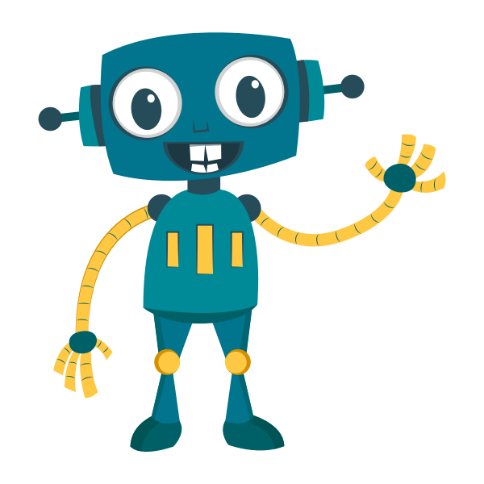
We want to print all elements of a list. This method works, however it is not ideal if our list contains many elements.
fruits = ["apple", "banana", "strawberry", "mango"]
print(fruits[0])
print(fruits[1])
print(fruits[2])
Instead, we can use a FOR loop to retrieve the elements in a list. This is crucial for very long lists!
fruits = ["apple", "banana", "strawberry", "mango"]
for i in fruits:
print(i)

Slide 7
Let’s practice!
03
Introduction to range()
for i in range(5):
print(i)
Result: This will repeat the loop a total of 5 times. On the first loop, i = 0. on the second loop, i = 1. This goes on until i = 5, which is where the loop stops.
01
Finding each element of a String (word, sequence of letters, etc.)
name = "Sebastian"
for i in name:
print(i)
range(START, STOP, STEP)
04
02
The first value is the start of the range, the second is the end of the range, and the third is the increment of the step.
for i in range(5,15,3):
print(i)
Find the SUM of all the elements in a list
numbers = [1, 4, 8, 12]
total = 0
for i in numbers:
total += i
print(total)

Slide 8

Will the elevator break?
Homework Description
A famous hotel in New York City has a faulty and very weak elevator. They've held back on fixing it because they are lazy and don't want to spend money.
By precaution, the can only allow 8 people on the elevator at a time.
A group of tourists arrive at the hotel. They all book a room for the night. Since they're all together, they decide to go up at the same time. We have the weight of each person in pounds: 208, 200, 350, 500, 127, 145, 134, 900
The elevator can only hold a MAXIMUM of 2500 pounds. You must determine if the elevator will break if they all use it at the same time! No need for a conditional.
1
You must create a list containing the weight of every person in the group of tourists.
4
Print() the total weight once the Loop is finished.
2
You will then define a variable for the total weight. This is where you’ll add the weight of every person.
5
Print() the number of people on the elevator using a list method.
3
You must use a FOR Loop to navigate the list you created.

Slide 9




Thank you!
Does anyone have any questions?
Next class: Class 6
Please contact us if you have any questions or if you want to notify us for anything.
Phone:
(438) 391-9106
Email:
hello@codeu.ca

